Slide 1
MEDI-CAL Program Overview
COVERED CALIFORNIA AGENTS PRESENTATION
AUGUST 15, 2018

Slide 2
PRESENTATION GOAL
Provide an overview of the following:
Medi-Cal Program
Application Processing
Household Composition
Coverage for Immigrants
Medi-Cal Renewals

Slide 3
Medi-cal program

Slide 4
Medi-Cal
Medi-Cal is the name for the Federal Medicaid Program in California.
Medi-Cal is a public health insurance program that provides health care coverage for individuals with limited income and resources.
With the implementation of the Affordable Care Act, Medi-Cal was separated into two major groups:
Modified Adjusted Gross Income (MAGI) Medi-Cal
Non-MAGI Medi-Cal

Slide 5
Medi-Cal
Who can receive Medi-Cal:
Children under 19 years of age
Adults 19-64 years of age
Parents/Caretaker Relatives
Pregnant Women
Persons in skilled nursing facilities
Seniors 65 and older
Disabled individuals (Meeting Social Security Administration disability criteria)

Slide 6
MAGI MEDI-CAL
MAGI Medi-Cal eligibility is determined based on Federal tax rules.
Income and tax household composition are considered in the eligibility determination.
Self-attested information can be electronically verified (e-Verified).
There is no asset test (property evaluation) under MAGI Medi-Cal.

Slide 7
MAGI MEDI-CAL
MAGI eligibility now includes childless single adults who:
Are between 19-64 years of age, and
Have income up to 138% of the Federal Poverty Level (FPL).
The following groups are now evaluated under MAGI methodology:
Children under age 19 - income up to 266% FPL
Parents/Caretaker Relatives - income up to 109% FPL
Pregnant Women - income up to 213% FPL

Slide 8
NON-MAGI MEDI-CAL
Non-MAGI Medi-Cal is the term for the Medi-Cal programs that existed before, January 01, 2014.
Program rules remain the same.
Income and Property are considered in the eligibility determination.
Share-of-Cost (SOC) Medi-Cal is determined under Non-MAGI Medi-Cal.

Slide 9
NON-MAGI MEDI-CAL
Non-MAGI Medi-Cal programs include:
Supplemental Security Income (SSI)
Foster Care/Former Foster Care Children
CalWORKs
Seniors (65 or over) and Persons with Disabilities
Long Term Care (LTC)
Home and Community Based Waiver
Medicare Savings Programs (MSP)
Medically Needy (MN)
MN Sneede
250% Working Disabled Program
Pickle Program
Minor Consent

Slide 10
Application processing

Slide 11
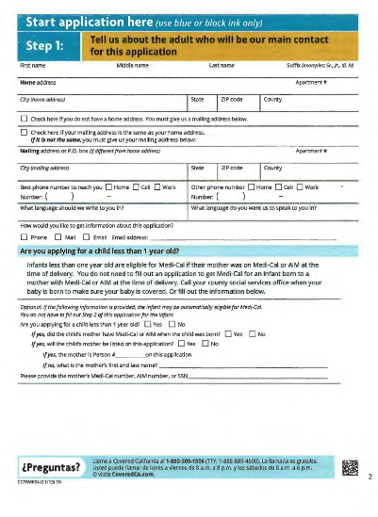
APPLICATIONs
The Single Streamlined Application (SSAPP) is used to apply for the following health insurance affordability programs:
Medi-Cal (MAGI & Non-MAGI), and
Subsidized Coverage (APTC/CSR).
Does not capture property or resource information.
Applications are processed within 45-days.
No-wrong door policy.
Notes:
The SSApp can be used to start a Non-MAGI application, but additional information must be collected (such as property and resources with supplemental forms).
The MC 210 PS – Property Supplement may used in conjunction with the SSApp to obtain asset information.

Slide 12
APPLICATIONS
Application Highlights:
Informs applicant of Deemed Eligibility – page 2
Captures the following for each person:
Tax information
Income
Former Foster care
Language designation
Authorized Representative designation – page 15
Rights and Responsibilities – page 16-17
Signature Page – page 17
Evaluation for all Medi-Cal Programs questions – page 18
Attachment E (immigration status list, self-employment expenses, other income list, and income deductions list) – page 27
Notes:
The SSApp can be used to start a Non-MAGI application, but additional information must be collected (such as property and resources with supplemental forms).
The MC 210 PS – Property Supplement may used in conjunction with the SSApp to obtain asset information.

Slide 13
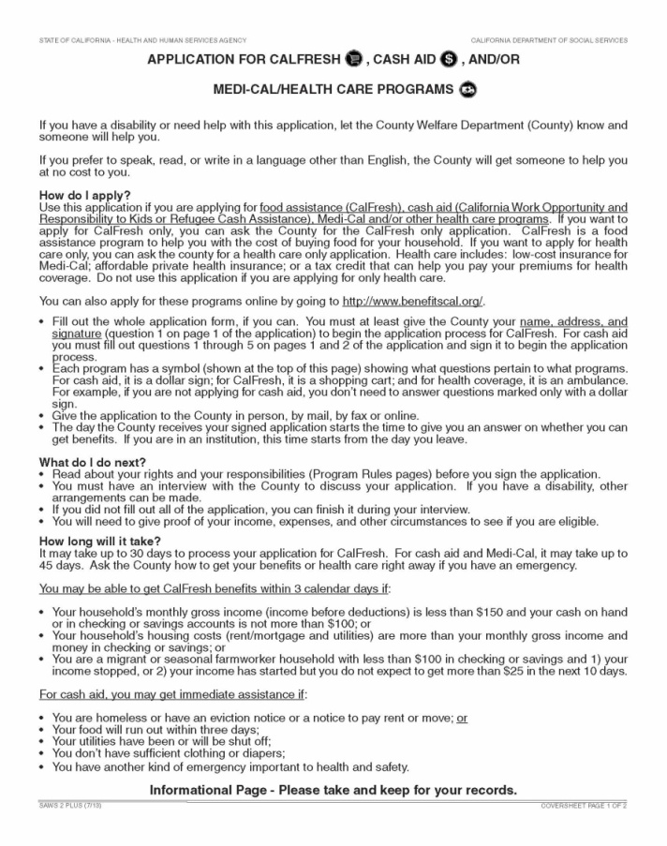
APPLICATIONS
The State revised the SAWS 2 application, and renamed it the “SAWS 2 Plus.”
The SAWS 2 Plus now includes the request for tax filer household information.
The SAWS 2 Plus can be used to apply for Medi-Cal and another program, such as CalFresh or CalWORKs.
CalWORKs

Slide 14
APPLICATIONS
How to Apply for Medi-Cal:
On-line via Your Benefits Now (YBN) by logging on to https://www.dpssbenefits.lacounty.gov.
Request an application by calling the DPSS Customer Service Center (866) 613-3777.
Visit us at http://dpss.lacounty.gov and click on Health Care for a Medi-Cal application.
In person at any Department of Public Social Services (DPSS) District Office or outreach site.
Through Covered California at CoveredCA.com, or by calling (800) 300-1506.
Notes:
The SSApp can be used to start a Non-MAGI application, but additional information must be collected (such as property and resources with supplemental forms).
The MC 210 PS – Property Supplement may used in conjunction with the SSApp to obtain asset information.

Slide 15
HOUSEHOLD COMPOSITION

Slide 16
HOUSEHOLD COMPOSITION
MAGI
VS.
NON-MAGI
TAX FILER HOUSEHOLD
HOUSEHOLD COMPOSITION
DAD
CHILD
MOM
DAD
CHILD
MOM
GRANDMA
GRANDMA
One Case / Separate MBUs
Resources Exempt
Two Separate Cases
Resources Counted
Notes:
Tax Filer Household:
Even if Grandma is receiving Social Security Retirement, if Dad claims her as a dependent, her income is counted in the household.
If Grandma filed her own tax return, it would be two separate households.

Slide 17
COVERAGE FOR IMMIGRANTS

Slide 18
QUALIFIED IMMIGRANTS
Qualified Immigrants - Term used by Medi-Cal to define immigrants who are eligible for full-scope Medi-Cal benefits.
Qualified Immigrants may include:
LPRs
PRUCOL, including some of the following:
Victims of Trafficking,
Refugees,
DACA,
Cuban and Haitian Entrants Program (CHEP),
Individuals Paroled in the U.S. for at least one year,
Individuals Granted Withholding of Deportation/Removal, and
Spouses and Children of Violence Against Women Act (VAWA)
Notes:
Citizen, LPR, Undoc, or PRUCOL…(all prucol categories provide Full-scope MC)

Slide 19
UNDOCUMENTED IMMIGRANTS
Undocumented Immigrants
If all other program requirements for Medi-Cal are met, will be eligible to receive restricted/limited scope benefits only.
Undocumented Immigrants in need of LTC:
If aged, blind and disabled, will be eligible under State funded Non-MAGI LTC Program with aid code 55 (restricted).
If between age 19 to 64, will be eligible under restricted MAGI aid codes.

Slide 20
MC 13 REQUIREMENTS
MC 13 Form - Statement of Citizenship, Alienage, and Immigration Status
The MC 13 form is no longer required for:
Individuals self-attesting U.S. citizenship or satisfactory immigration status, and
When status is verified via electronic means including the HUB, SAVE process, California birth match, or the Social Security Administration (SSA) citizenship verification process.
MC 13 is still required for individuals who do not meet the above conditions, and for those who are claiming PRUCOL and their immigration status cannot be electronically verified, including PRUCOL category #16.

Slide 21
PRUCOL
Permanently Residing Under Color of Law (PRUCOL)
PRUCOL is a public benefits category created by the federal courts but is not recognized as an immigration status by the U.S. Citizenship and Immigration Services (USCIS).
PRUCOL means that the USCIS is aware of an immigrant’s presence, but is not actively pursuing his or her deportation.
Medi-Cal benefits for immigrants under PRUCOL have not changed.

Slide 22
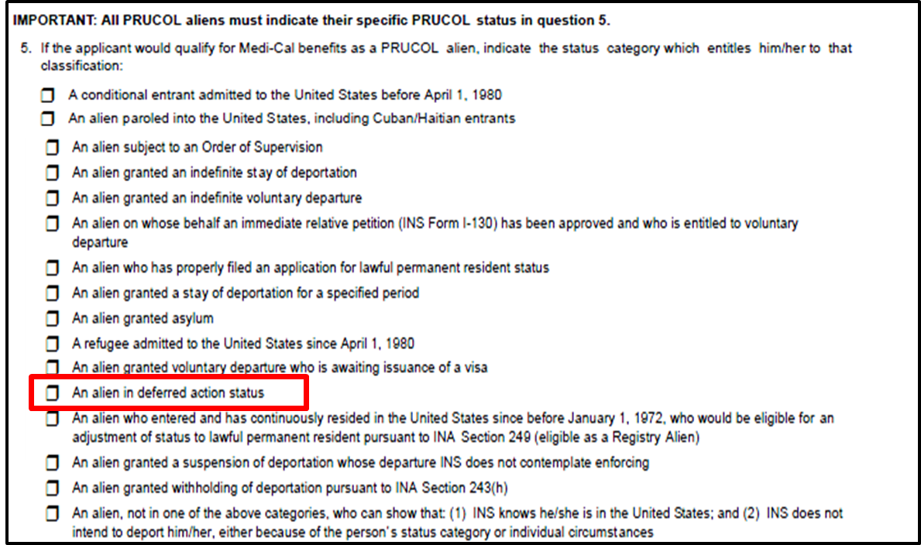
PRUCOL
MC13 - Section B, Question 5

Slide 23
Senate Bill 75
SB 75 was implemented on May 16, 2016, with coverage effective as of May 1, 2016.
SB 75 provides full scope Medi-Cal coverage to individuals under age 19 if otherwise eligible, regardless of immigration status.
New applicants under 19 will be determined eligible to full-scope Medi-Cal.
Beneficiaries with restricted-scope were transitioned to full-scope Medi-Cal.
Medi-Cal Managed care enrollment process applies.

Slide 24
MEDI-CAL RENEWALS

Slide 25
MAGI RENEWALS
Automated ex-parte review is the 1st step in the Renewal (RE) Process for MAGI cases only.
The automated process is system generated; no worker involvement is required.
Occurs two months prior to the RE due month.
System gathers the most current case information from all available sources (i.e. Active CalWORKs, CalFresh, or General Relief cases, or terminated within the last 90 days) to send to the Federal Data Hub via an e-HIT.
The goal is to obtain a successful e-hit with compatible results.
If results are not compatible, an MC 216 RE form is generated.

Slide 26
MAGI RENEWALS
MC 216 Pre-Populated Form
The form is only generated when the e-HIT is not compatible.
The form does not need to be returned, as long as the verification requested in the MC 216 is provided by the beneficiary.
The form is sent to MAGI households with individuals eligible under the following MAGI categories:
Parent/Caretaker Relative
Adult (19-64 years of age)
Children
Pregnant Women
The form is issued to obtain verification of income, death, or incarceration.

Slide 27
NON-MAGI RENEWALS
MC 210 RV Form
Is a mandatory form that must be returned by the beneficiary along with verification of income and property.
The form is sent to the Aged, Blind, Disabled, and Medically Needy beneficiaries not eligible to MAGI Medi-Cal.

Slide 28
NON-MAGI RENEWALS
MC 262 Form
Is a mandatory form that must be returned by the Long-Term Care (LTC) beneficiary along with verification of income and property.
The form is issued to all LTC beneficiaries at renewal.

Slide 29
NON-MAGI RENEWALS
MC 14 Form
Is a mandatory form that must be returned by the MSP beneficiary along with verification of income and property.
Is sent to all MSP beneficiaries at renewal.
Note: MSP is not a Medi-Cal Program. It is a Medicare Savings Program, such as QMB and SLMB populations.

Slide 30
MIXED HOUSEHOLD RENEWALS
Mixed Household RE Packets:
A mixed household RE packet is sent to Medi-Cal households that contain both MAGI and Non-MAGI aided individuals in the same case.
Depending on the results of the e-HIT, the mixed household may receive one of two packets.

Slide 31
MIXED HOUSEHOLD RENEWALS
If e-HIT is Compatible:
Eligibility is re-established for another year for the MAGI individuals and an MC 216 will not be generated.
Only the MC 604 IPS will be sent to the household for the Non-MAGI individuals.
The MC 604 IPS request property information, which is needed to determine ongoing Medi-Cal eligibility for Non-MAGI individuals.
The MC 604 IPS must be completed and returned to comply with the annual renewal process.

Slide 32
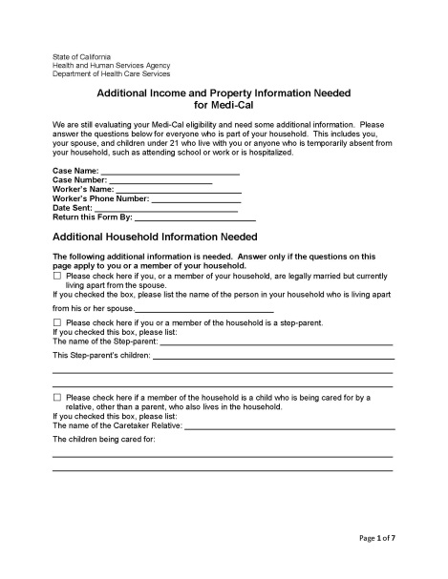
MIXED HOUSEHOLD RENEWALS
If e-HIT is Not Compatible:
Both the MC 216 and MC 604 IPS will be sent to the household.
The MC 216 does not need to be returned as long as the verification requested in the MC 216 is provided.
However, the MC 604 IPS must be completed and returned to comply with the annual renewal process.

Slide 33
RENEWALS VIA YBN
In October 2017, functionality was implemented in YBN to allow beneficiaries to complete and submit a Medi-Cal RE online.
Currently, beneficiaries receiving an MC 216 or MC 210 RV RE form can complete and submit their RE through YBN.
RE forms in YBN are currently available in English and Spanish.
The RE link in YBN is available through the entire cure period, or until the RE is submitted.
Verification documents can also be uploaded and submitted with the RE.

Slide 34
90-DAY CURE PERIOD
The cure period, commonly known as the rescission period, has been extended from 30 to 90 days (applies to MAGI and Non-MAGI).
During the cure period, the beneficiary must provide all required verifications before the case can be re-evaluated/ rescinded.
If the required verifications are received within the 90 day period, and Medi-Cal eligibility remains, benefits are restored with no break in aid.
The cure period does not apply to:
Case Denials, and
Client Request Terminations.
Notes:
There are some pre-ACA case that were updated as received, but the CH screens were never updated.

Slide 35
QUESTIONS

